Slide 1
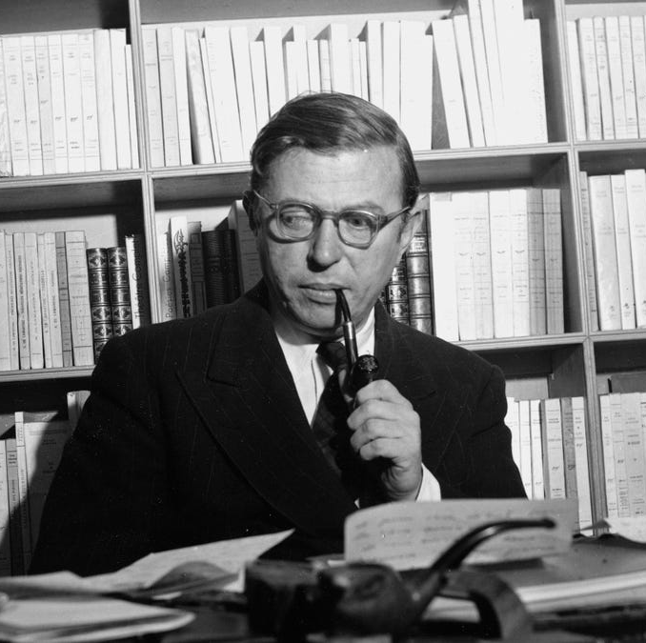
Jean-Paul Sartre
‘We Create Ourselves Through What We Do’

Slide 2
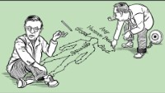

Slide 3
Key Ideas:
Unlike objects created for a purpose, humans first exist and then create their own purpose through their actions.
‘The Look’: When people pay attention to us it makes us aware of ourselves as objects. We feel them decide whether we have a purpose, and if our purpose is worthwhile. This leads to feelings of shame, pride, or even conflict.
People often deceive themselves into thinking they don't have choice. They do this to avoid responsibility for their actions. This self-deception is called "bad faith".
To live in good faith means taking responsibility for our actions, and striving to live authentically, even if it means going against societal norms or expectations.

Slide 4
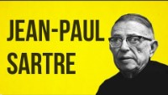

Slide 5
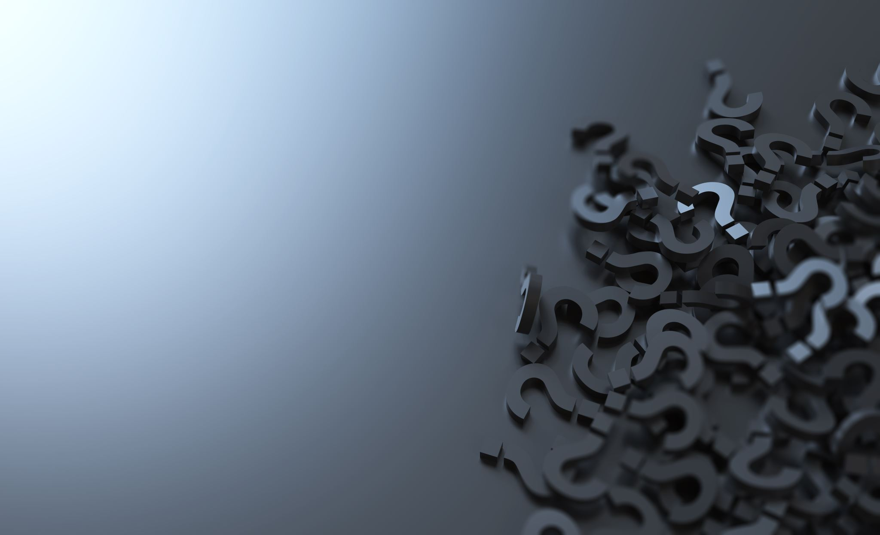
Discussion Questions:
What is an Authentic Life?
Are we closer to our true selves in times of crisis or during regular life?
How does the context of Nazi occupation of France during the early 1940's affect the meaning of this text?
If Sartre is right, what dilemmas does this present us in 21st century Australia?
What are some of the implications and assumptions suggested by this essay?
What are arguments in favour and against Sartre's position?

